Slide 1
버전 업그레이드 검증
KAKAOPAY
Palo Alto NGFW PA-5450

Slide 2
장비 및 케이블 준비
교체 테스트 용
4T SSD
DPC
4T SSD
NC
* 수량 확보 철저
40G GBIC
40G GBIC
5450 POWER
Copper GBIC
MGMT Cable
PA-5450
MPC
Switch
5450 POWER
MGMT Cable
40G GBIC
40G GBIC
DPC
100G GBIC
DPC
40G GBIC
40G GBIC
NC
100G GBIC
Switch POWER
10G GBIC
NC
Switch POWER
40G GBIC
40G GBIC
HA1 Cable
IXIA
BP
40G GBIC
40G GBIC
10G GBIC
MGMT Cable
PA-5450
MPC
100G GBIC
Switch
40G GBIC
40G GBIC
DPC
100G GBIC
DPC
40G GBIC
40G GBIC
NC
Switch POWER
5450 POWER
NC
Switch POWER
40G GBIC
40G GBIC
5450 POWER
MGMT Cable
Copper GBIC
종류 | Switch | PA-5450 | 100G GBIC | 40G GBIC | 10G GBIC | Copper GBIC | 100G Cable | 40G Cable | 10G Cable | 4T SSD | MGMT Cable | 5450 Power | Power | DPC | NC | MPC
필요 수량 | 2 | 2 | 5~6 | 18~22 | 3~4 | 2~3 | 3~4 | 10~12 | 2~3 | 2 | 8~9 | 4~5 | 4~5 | 5 | 5 | 2
실수량

Slide 3
트래픽 흐름도
* 구성
10.10.1.1/24 (vlan1) 10.10.4.1/24 (vlan4) 10.10.5.1/24 (vlan5)
Trunk
eth1/49
eth1/25
10.10.1.2/24 (vlan1) 10.10.4.2/24 (vlan4) 10.10.5.2/24 (vlan5)
Switch
PA-5450
Trunk
eth1/50
eth1/26
eth1/53
eth1/51
eth2/25
100G GBIC
eth1/52
eth2/26
10G GBIC
IXIA
BP
eth1/49
eth1/25
10G GBIC
100G GBIC
Switch
PA-5450
eth1/50
eth1/26
eth1/53
20.20.1.2/24 (vlan1) 20.20.10.2/24 (vlan10) 20.20.11.2/24 (vlan11) 20.20.12.2/24 (vlan12)
eth1/51
eth2/25
Trunk
eth1/52
eth2/26
20.20.1.1/24 (vlan1) 20.20.10.1/24 (vlan10) 20.20.11.1/24 (vlan11) 20.20.12.1/24 (vlan12)
Trunk

Slide 4

트래픽 흐름도
* 1호기
40G GBIC
40G GBIC
Switch
PA-5450
10.1.0.2/16
40G GBIC
40G GBIC
100G GBIC
10.1.0.1/16
40G GBIC
40G GBIC
100G GBIC
10.2.0.2/16
40G GBIC
40G GBIC
10G GBIC
IXIA
BP
40G GBIC
40G GBIC
10G GBIC
100G GBIC
Switch
PA-5450
40G GBIC
40G GBIC
10.1.0.2/16
10.2.0.1/16
100G GBIC
40G GBIC
40G GBIC
10.2.0.2/16
40G GBIC
40G GBIC

Slide 5
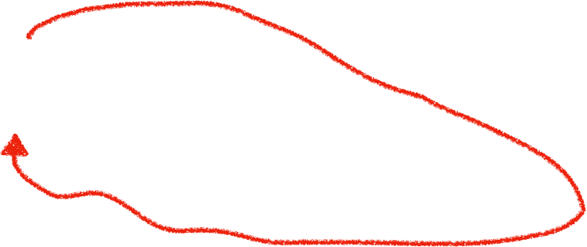
트래픽 흐름도
* 2호기
40G GBIC
40G GBIC
Switch
PA-5450
10.1.0.2/16
40G GBIC
40G GBIC
100G GBIC
10.1.0.1/16
40G GBIC
40G GBIC
100G GBIC
10.2.0.2/16
40G GBIC
40G GBIC
10G GBIC
IXIA
BP
40G GBIC
40G GBIC
10G GBIC
100G GBIC
Switch
PA-5450
40G GBIC
40G GBIC
10.1.0.2/16
10.2.0.1/16
100G GBIC
40G GBIC
40G GBIC
10.2.0.2/16
40G GBIC
40G GBIC

